Slide 1


A Minor Project Report on
“SMART SCARECROW”
Team # 10
Presented by:
Rudragouda Patil | 01FE21BME410
Rohit Vernekar | 01FE20BME133
Nandish Appoji | 01FE20BME076
Somu k | 01FE20BME111
Nandan Jadhav | 01FE20BME068
Bangarappa Bannad | 01FE20BME059
Under the Guidance of
Prof. Gururaj Fathepur
Prof. Girish
School of Mechanical Engineering
K.L.E Technological University,
Vidyanagar, Hubbali
23-May-2023
2022-2023

Slide 2
Contents:
Problem Statement
Product Benchmarking
Objective Tree
Morphological Chart
Design Alternatives
Pugh Chart
Assembly CAD Model
Design Calculations
FEM Analysis
Circuit Diagram
Electronic Components
IoT/ Mobile App GUI
Final Product Photos
Product Catalogue

Slide 3
Problem Statement
Brief Problem statement to be defined here
End Users:

Slide 4
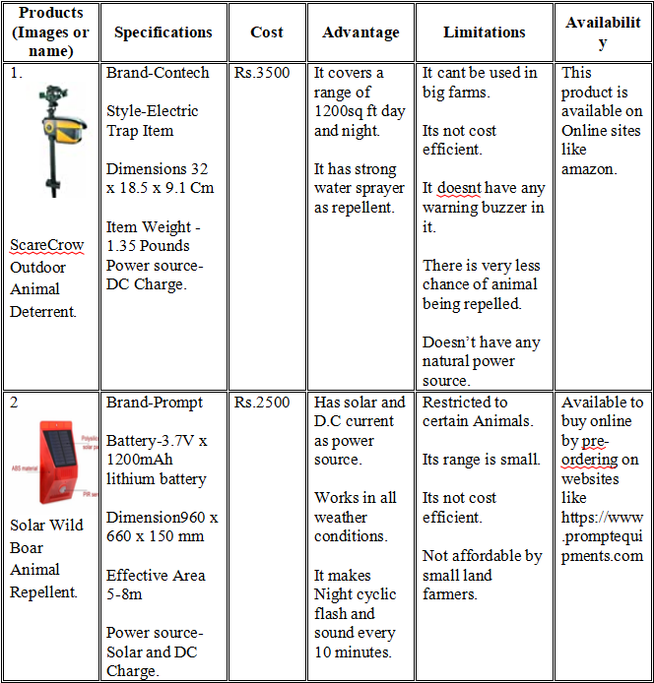
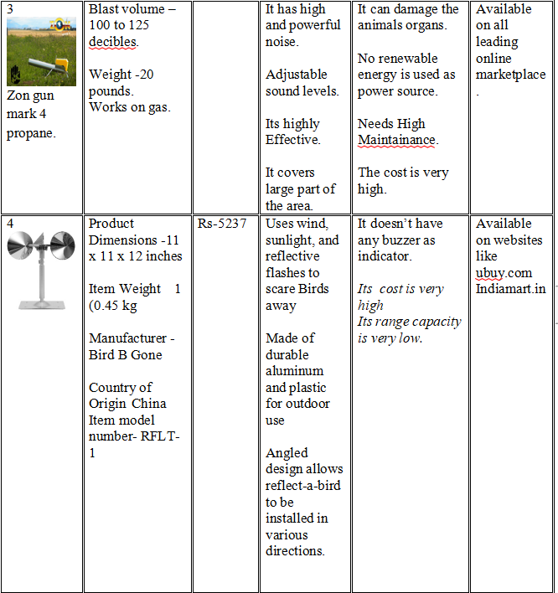
Product Benchmarking

Slide 5
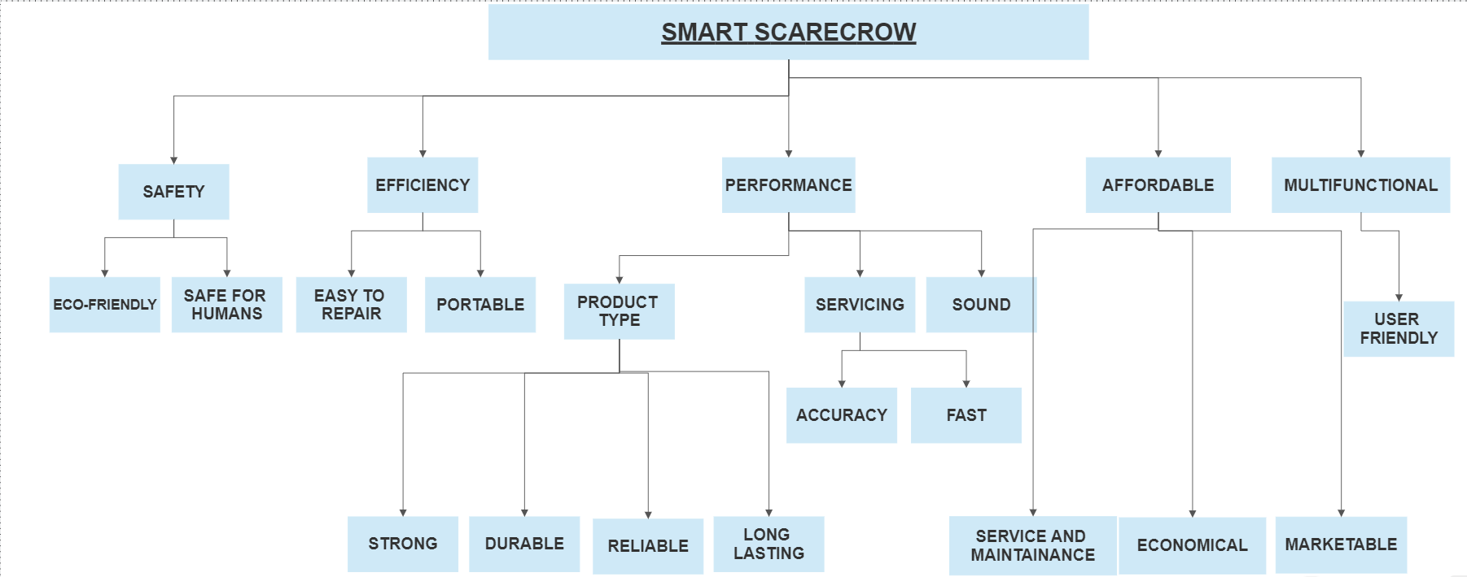
Objective Tree

Slide 6
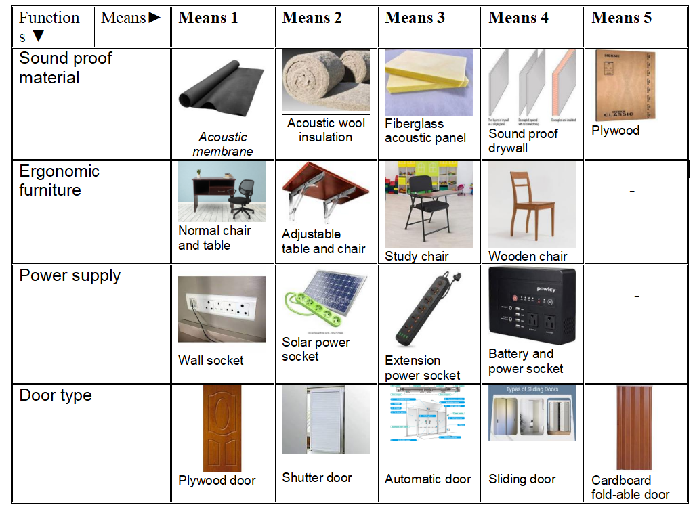

Morphological Chart

Slide 7
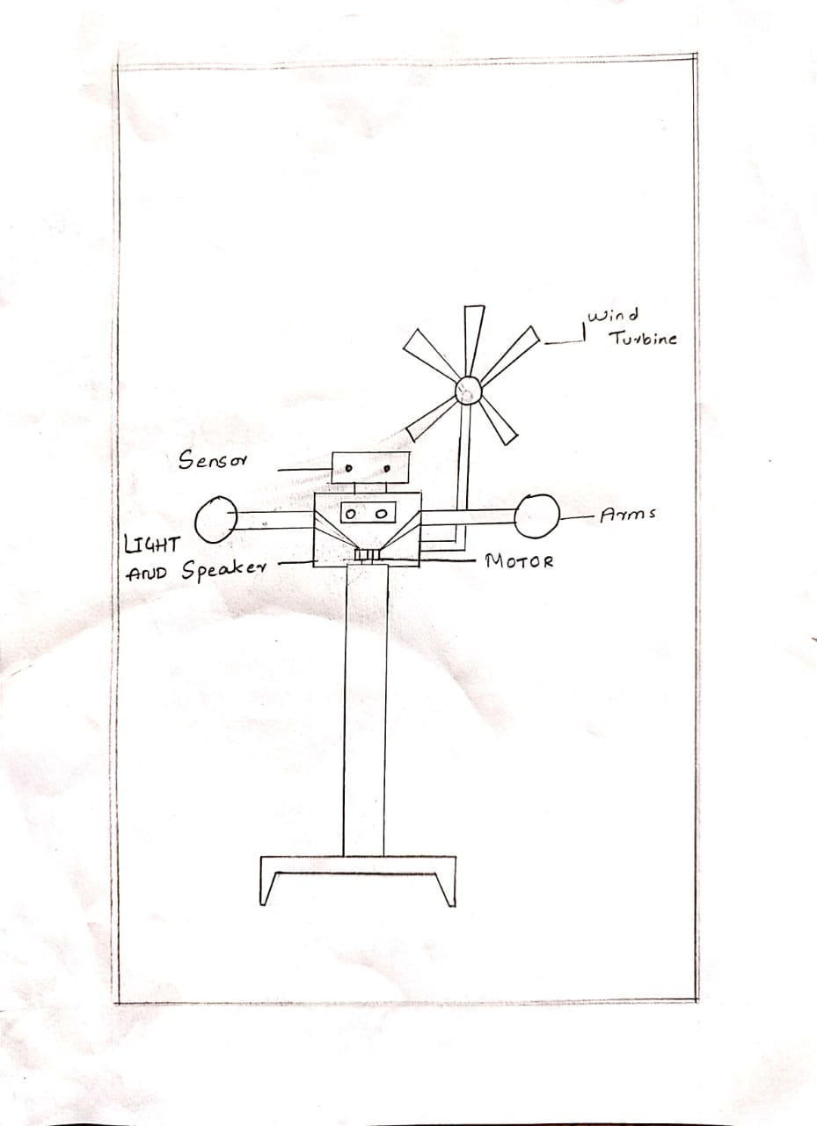
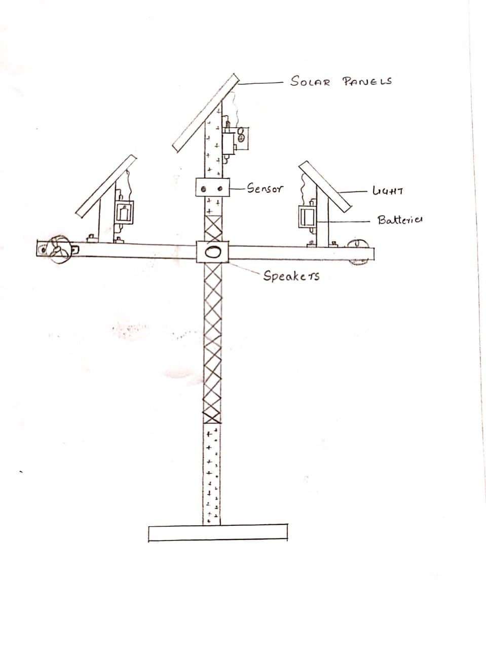
Design Alternatives
Alternate 1
Alternate 2

Slide 8
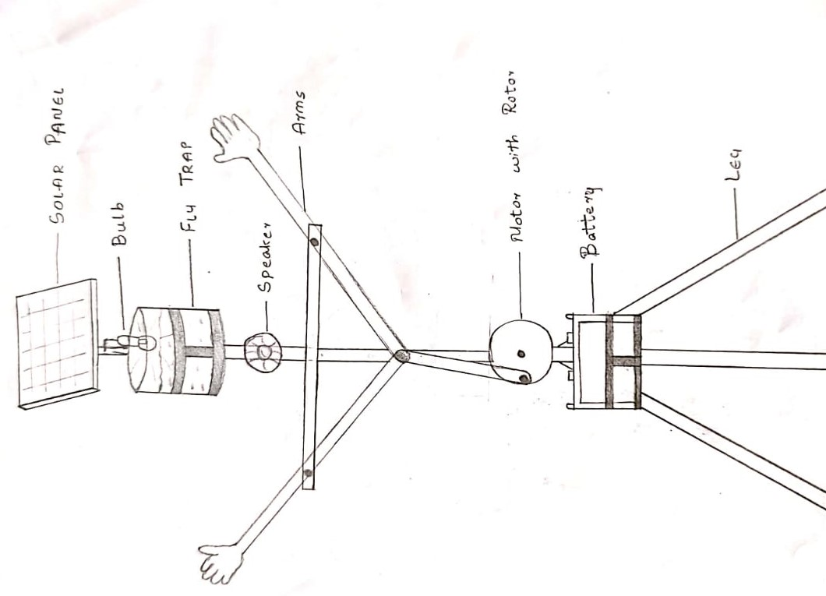
Design Alternatives
Alternate 3

Slide 9
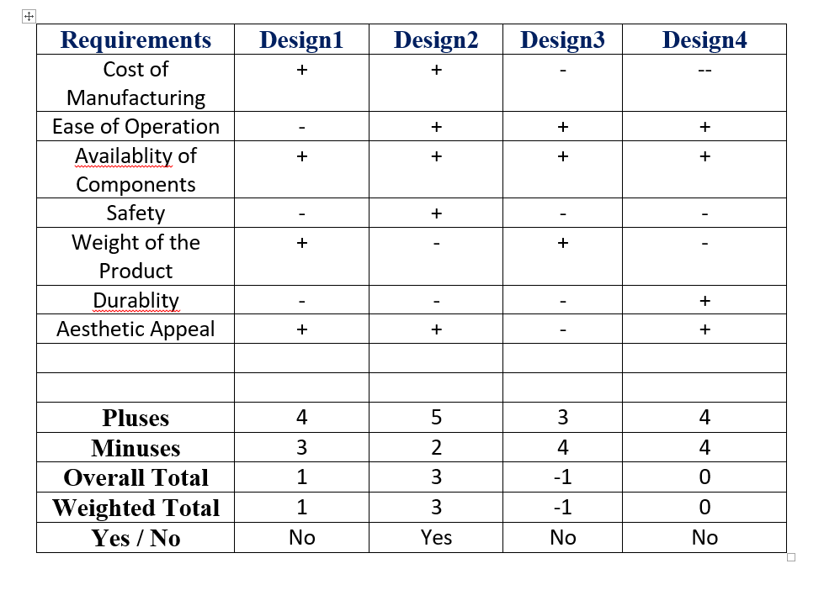
Pugh Chart

Slide 10
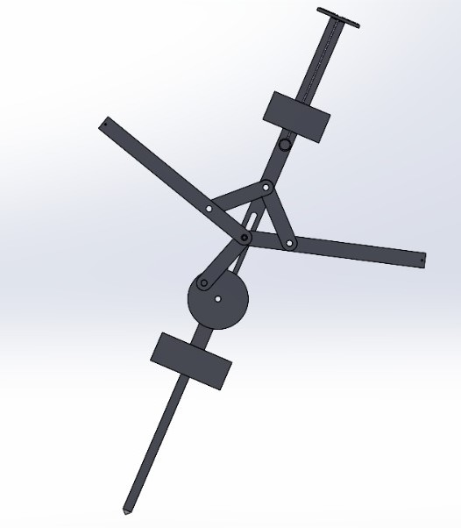
Assembly CAD Model

Slide 11
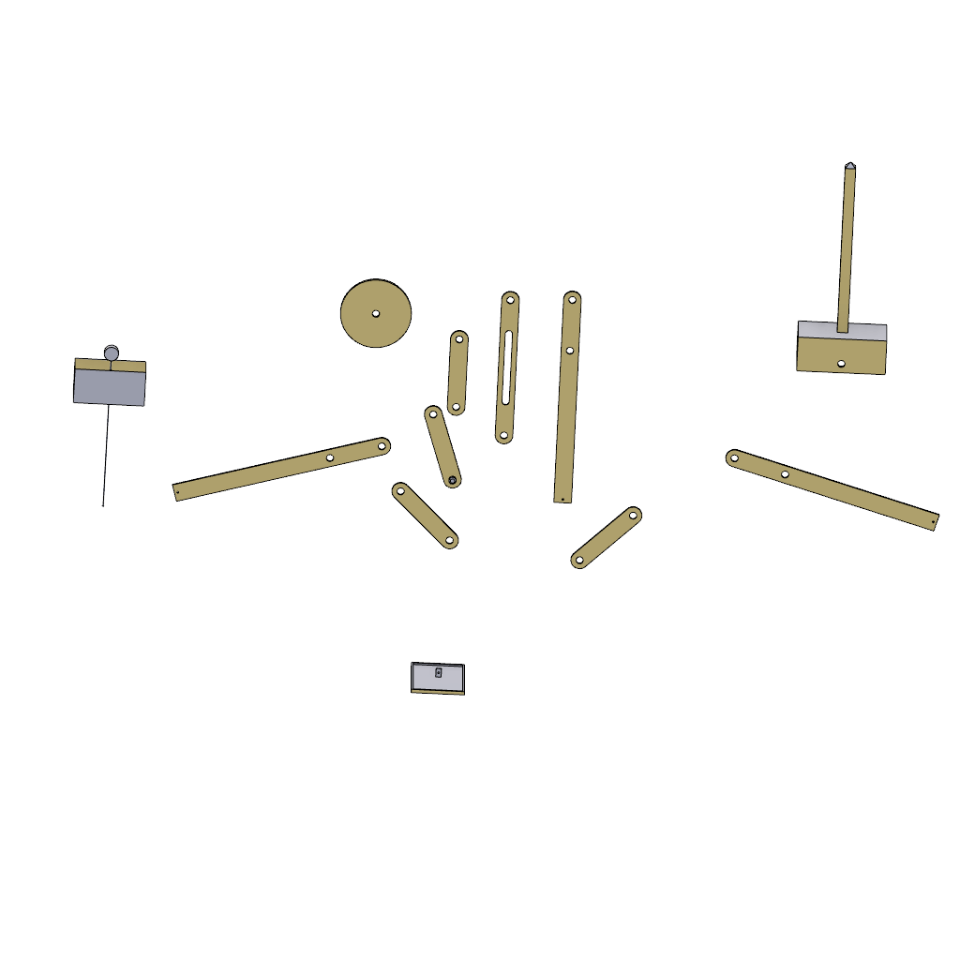
Assembly CAD Model (Exploded view)

Slide 12
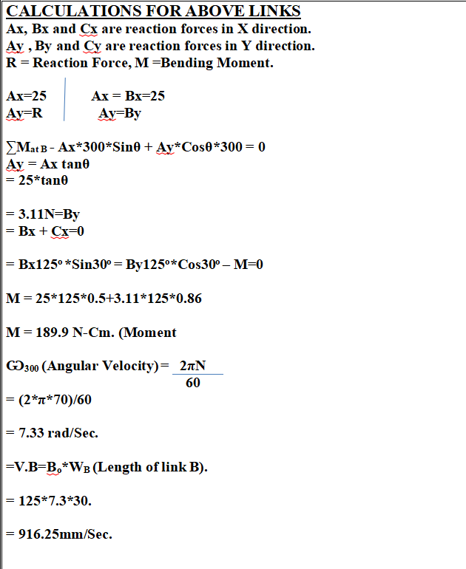
Design Calculations

Slide 13
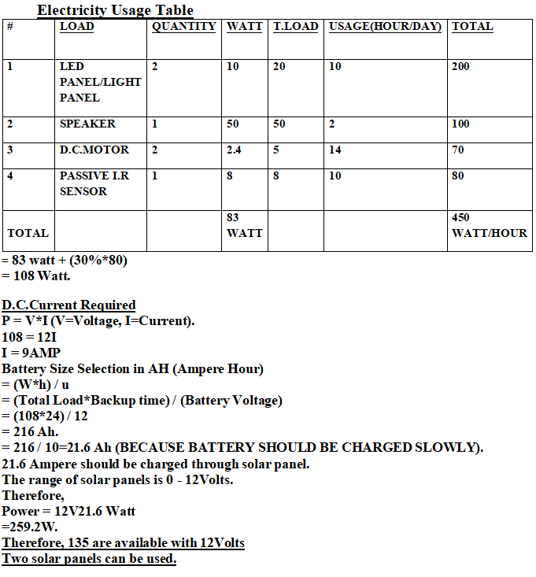
Design Calculations (contd..)

Slide 14
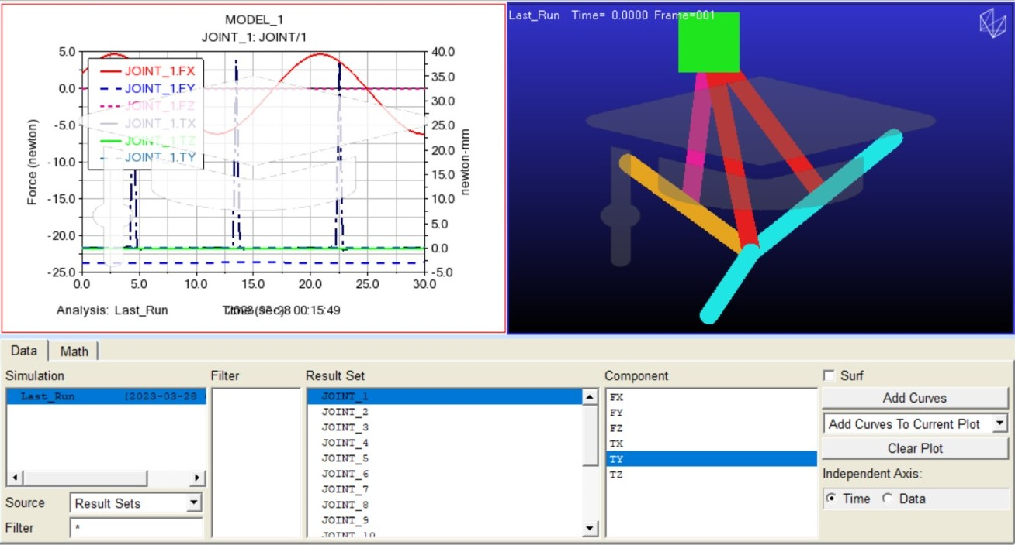
FEM Analysis

Slide 15
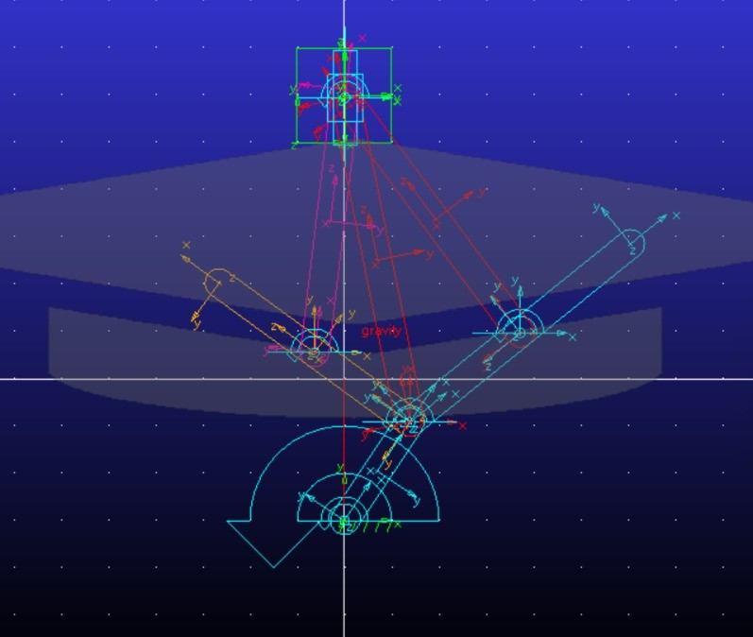
FEM Analysis

Slide 16
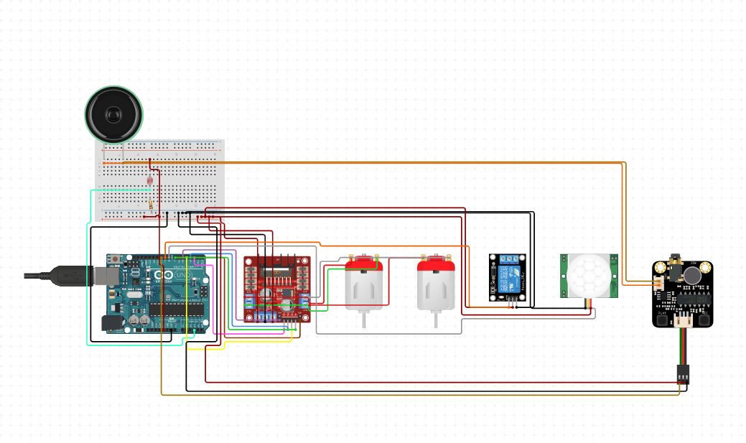
Circuit Diagram

Slide 17
Product Catalogue

Slide 18
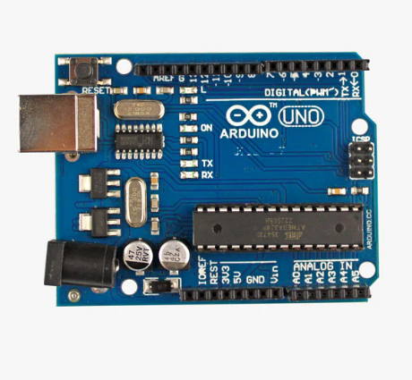
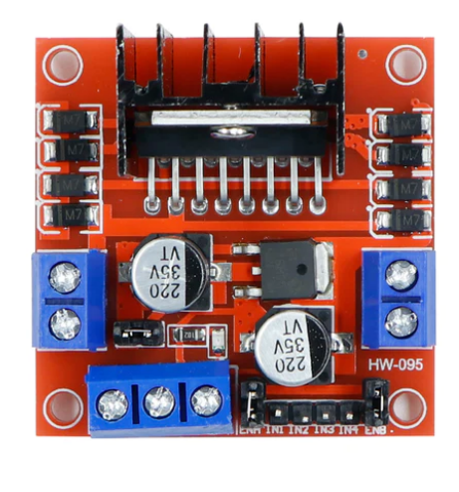
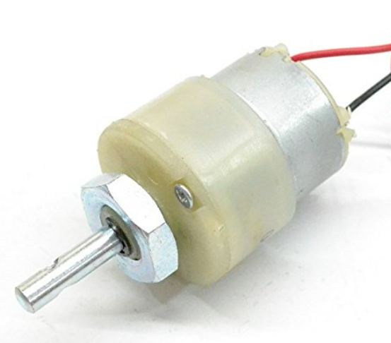
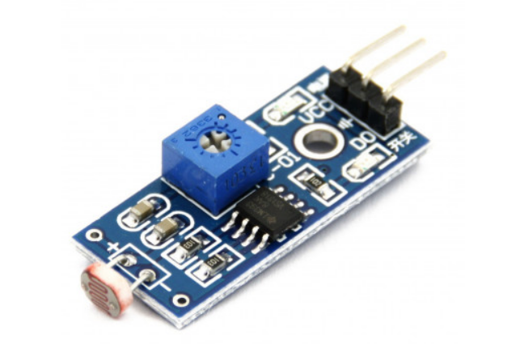
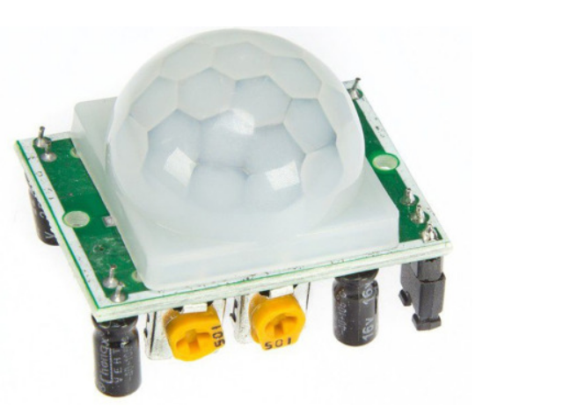
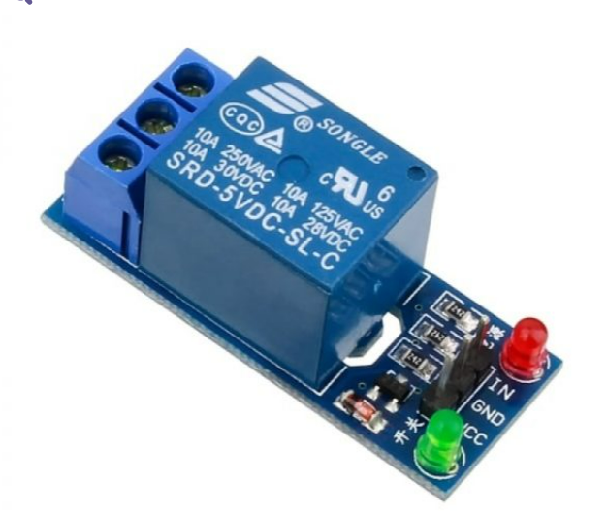
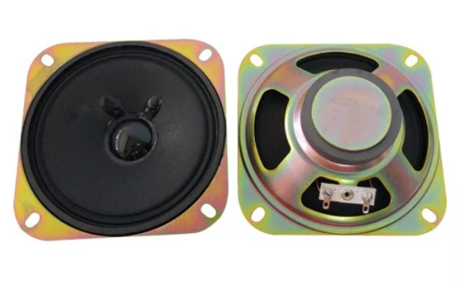
Electronic Components Used
L298N MOTOR DRIVE
LDR SENSOR
10 RPM DC MOTOR
ARDUINO UNO
RELAY MODULE
4 OHM SPEAKER
PIR SENSOR

Slide 19
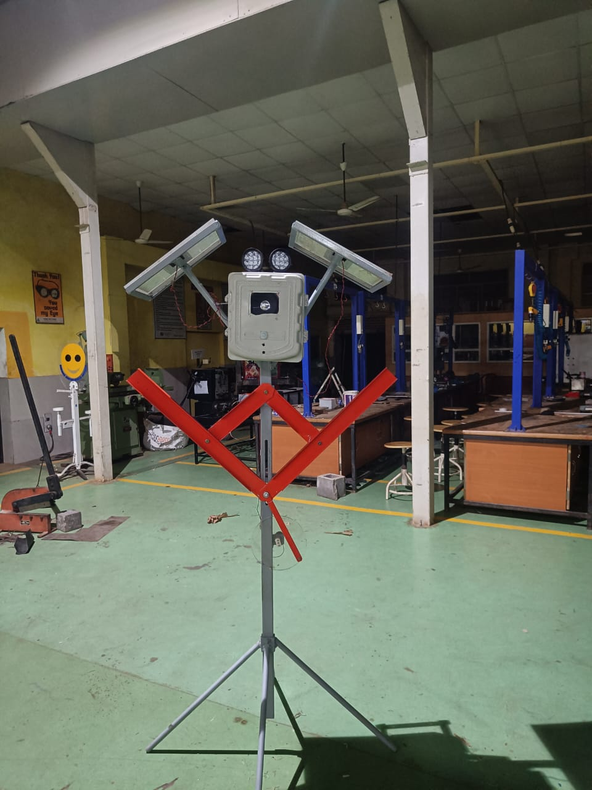
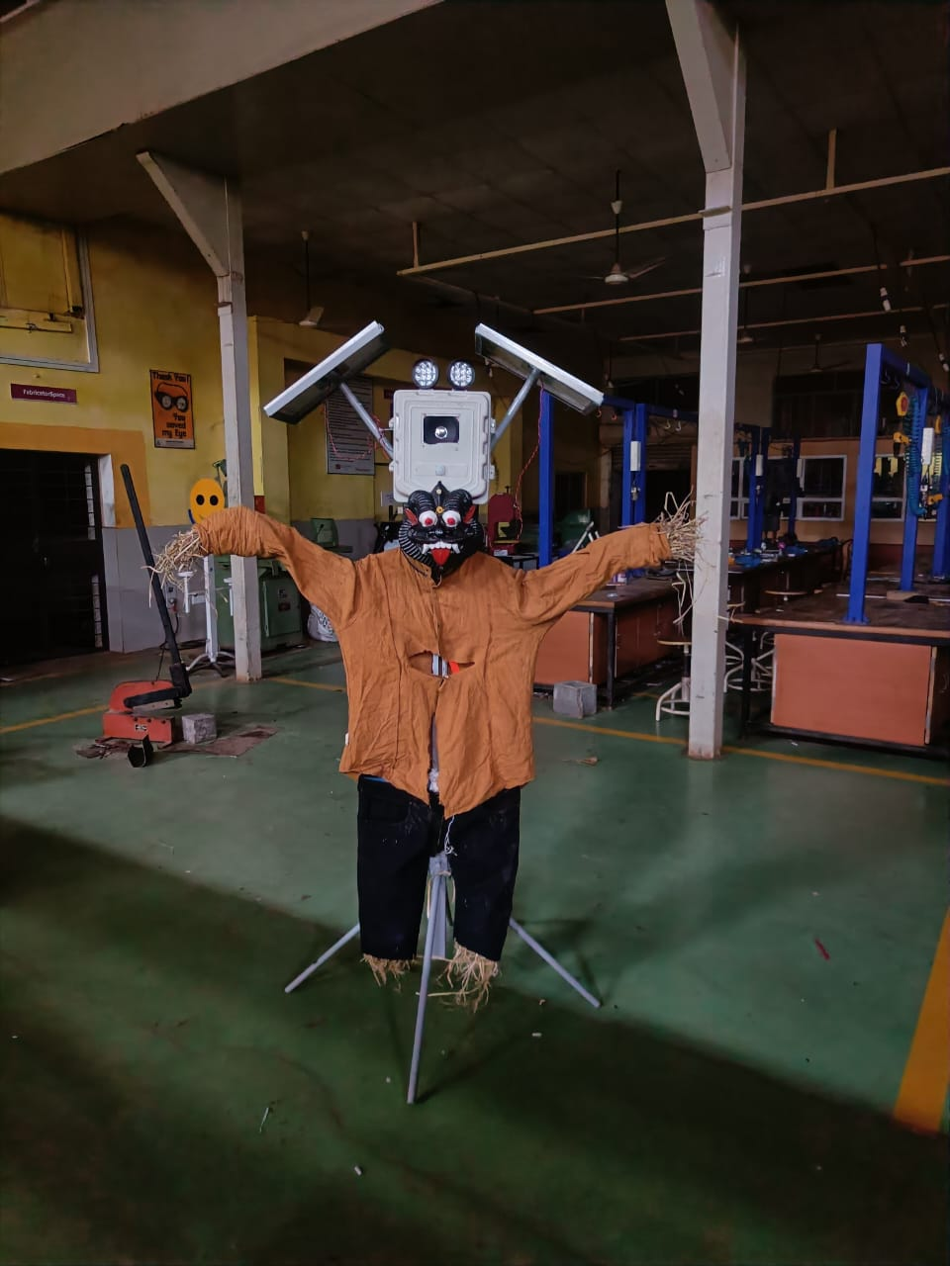
Final Product Photos

Slide 20
Thank You!!

